Slide 1
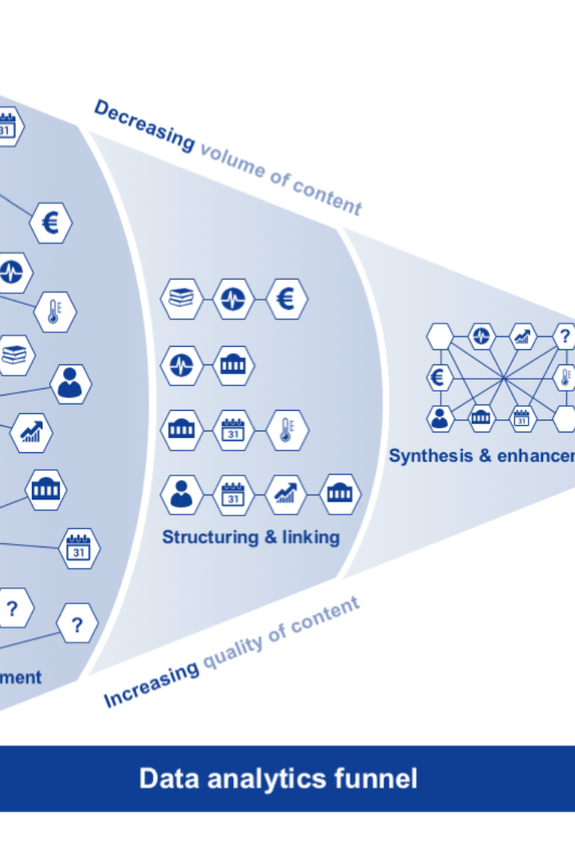

Big Data Analysis with IBM Cloud Database
Welcome to the world of Big Data Analysis! Discover how IBM Cloud Database can revolutionize your data analysis processes and unlock valuable insights.

Slide 2

Introduction to Big Data Analysis
Big Data Analysis is the process of extracting meaningful information from large and complex datasets. It helps organizations make data-driven decisions and uncover hidden patterns and trends.

Slide 3
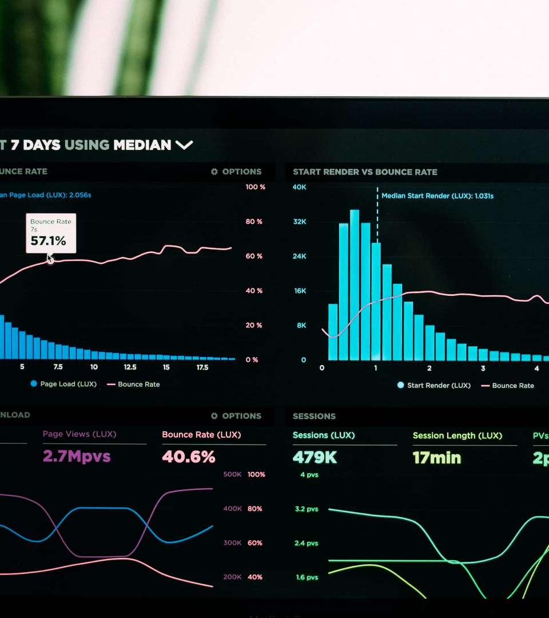
What is Big Data?
Big Data refers to extremely large and diverse datasets that cannot be processed using traditional data processing techniques. It includes structured, unstructured, and semi-structured data.

Slide 4

Why is Big Data important?
1
Valuable insights
2
Better decision-making
Helps businesses stay ahead.
Provides accurate information.
3
Enhanced customer experiences
4
Innovation
Creates personalized experiences.
Identifies new opportunities.

Slide 5
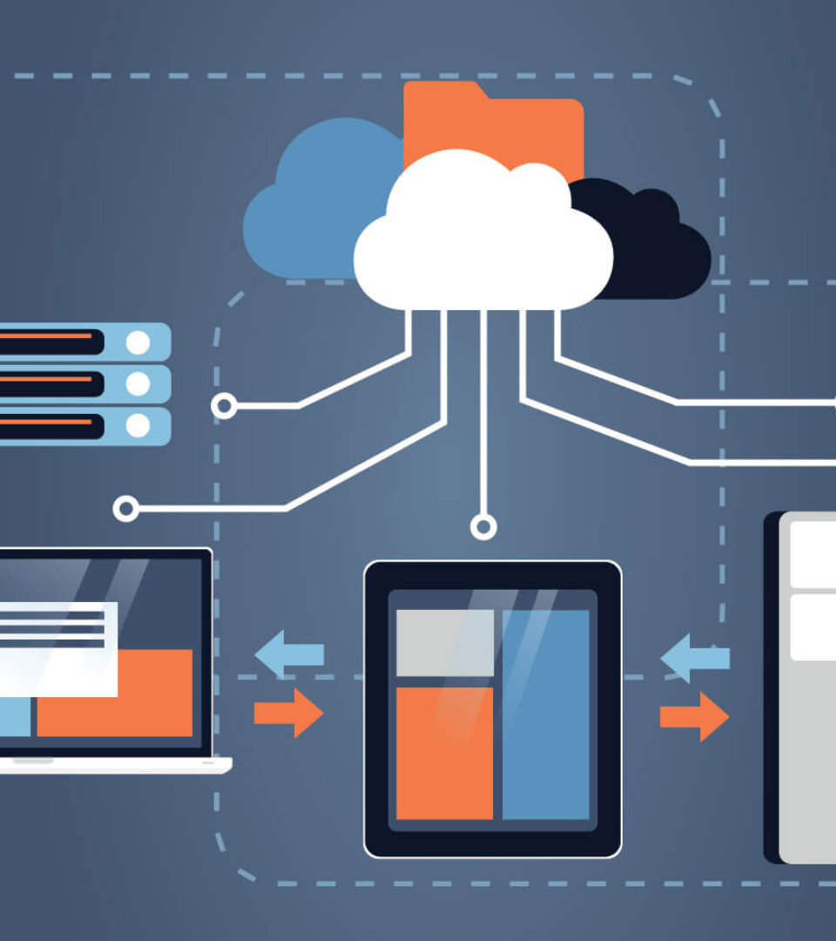
Overview of IBM Cloud Database
IBM Cloud Database is a powerful and secure cloud-based platform that enables efficient storage, management, and analysis of large-scale datasets. It offers scalability, reliability, and ease of use.

Slide 6
Features and Capabilities of IBM Cloud Database
Scalability
Security
Easily scale your infrastructure to handle growing data volumes and changing business needs.
Protect your data with advanced security measures, encryption, and access controls.
Analytics Tools
Data Integration
Utilize built-in analytics tools for efficient data exploration, visualization, and predictive modeling.
Seamlessly integrate data from various sources, including structured and unstructured data.

Slide 7
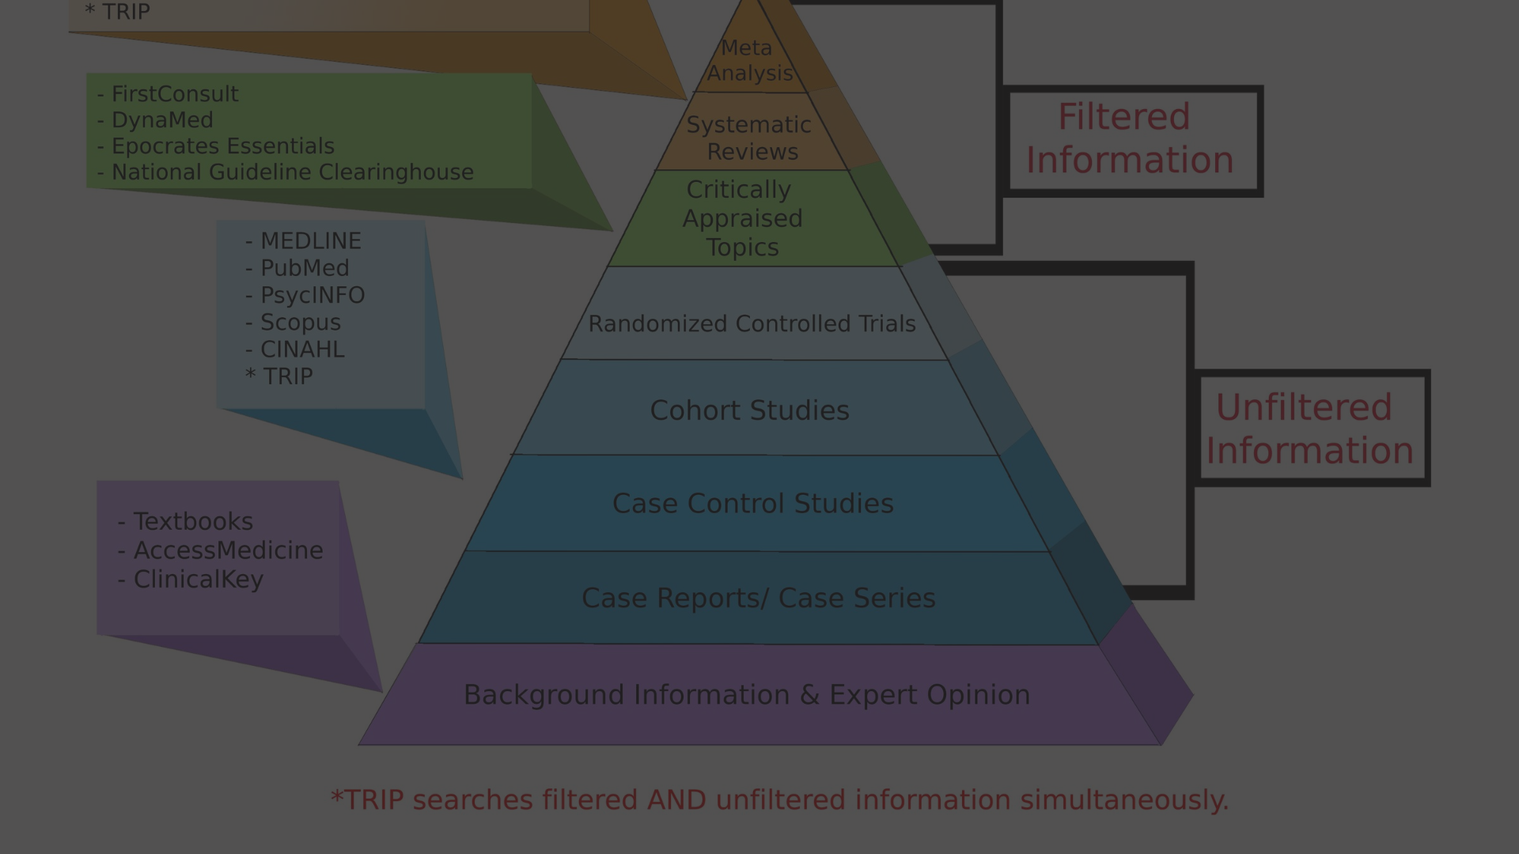
Benefits of using IBM Cloud Database for Big Data Analysis
1
Cost Savings
2
Flexibility
Reduce infrastructure costs by eliminating the need to invest in costly on-premises hardware and software.
Enjoy the flexibility of deploying and managing your Big Data solutions in the cloud, accessible from anywhere.
3
Speed and Performance
4
Collaboration
Leverage the speed and performance of IBM Cloud Database to process and analyze large datasets quickly.
Enable collaboration among teams by providing centralized access to data and analysis tools.

Slide 8

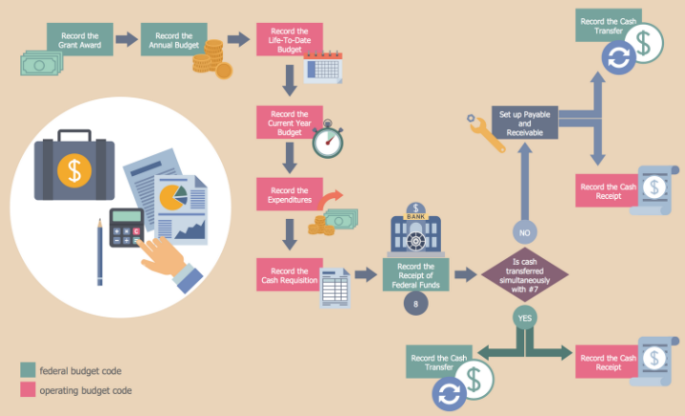
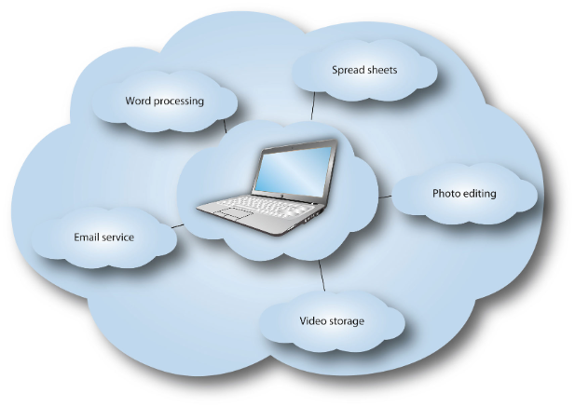

Slide 9




Case Studies and Examples of Successful Big Data Analysis with IBM Cloud Database+
Retail Industry
Healthcare Sector
Discover how IBM Cloud Database helped a leading retailer analyze customer behavior and optimize inventory management.
Explore how IBM Cloud Database enabled healthcare organizations to analyze patient data for early disease detection and personalized treatments.
Financial Services
Smart City Initiatives
Learn how IBM Cloud Database empowered financial institutions to perform real-time financial analysis and fraud detection.
See how IBM Cloud Database supported smart cities in analyzing sensor data to improve public services and enhance urban living.

Slide 10

DONE BY :
TEAM CODE : 215353
COLLEGE CODE : 7327
T. MOULIDHARAN
V. ASHOKKUMAR
R. SARAVANAN
S. SHIVASURYA
V. MANIKANDHAN

